Slide 1

Soft skills and jobs in Haiti:
Early Lessons from the Haiti AGI Pilot
Aude-Sophie Rodella & Facundo Cuevas
LCSPP – December 2013

Slide 2
Key Questions
[1] Why work on soft skills in a low-skill setting?
[2] How to design a soft skills training program?
[3] How to implement a soft skills program to enhance a technical skills program?
[4] Why we need to know more (and about what) ?
Notes:
Enhances cost-effectiveness of technical skills program.
Research Agenda.

Slide 3
[1] Why work on soft skills in a low-skill setting?
There is a growing recognition of the importance of socio-emotional/behavioral/non-cognitive/’soft’ skills in both educational and labor market outcomes and overall endowments.
Those skills are also crucial to developing and exercising agency, i.e. the capacity to make choices and translate them into desired actions and outcomes (WDR 2012).

Slide 4
[1] Why work on soft skills in a low-skill setting?
However under this terminology, a wide range of skills are aggregated, mixed and matched in a way that makes the interventions aimed at developing those skills hard to compare. In fact, the diversity within and across disciplines poses problems for both measurement and investment (ter Weel, Heckman et al., 2008);
Still, existing literature indicates that in developing countries, upper-cognitive and social-behavioral skills are equally or more valued than technical skills. This is in part due to the higher need for adaptability in those contexts, a situation especially true in the case of informal labor markets and vulnerable groups.
Notes:
Definition issues

Slide 5
[1] Why work on soft skills in a low-skill setting?
Employers tell us they value ‘good behaviors’: arriving on time, self-esteem, respect, team-player, initiative.
Agency is key to achieve employment aspirations, to have the self-efficacy that can complement technical skills to foster employability.
Beneficiaries report high degrees of satisfaction and unequivocally qualify soft skills training as key (qualitative evaluation).
Upcoming next quarter: IE results

Slide 6
[2] How to design a soft skills training program?
Crucial questions to tackle:
Types of skills to be taught?
How to make it context appropriate?
Type of administration of training?
Intensity and duration of training?
How to ensure the quality of the training (from curriculum to implementation of training)
Sustainability of soft-skills training impact?

Slide 7
[2] How to design a soft skills training program?
Review of existing modules – international best practices and curriculum used in Haiti
Recruiting of a Haitian psycho-pedagogue to adapt the curriculum to the context and targeted audience
Recruiting of a local illustrator to contextualize the module
Consultations with NGO mentors to validate the modules and collect experience to enhance interactive dimension of training.
Training of the mentors charged with administrating the modules to ensure quality and consistency

Slide 8
The Eight Modules of the Haiti AGI Curriculum
Edikasyon sikososyal (Education psycho-social)
Angajman sitwayen ak lidèchip ( Civic engagement and leadership)
Vyolans ki chita sou jan sosyete a we fi ak gason (gender-based violence)
Sante seksyèl ak repwodiktif (Sexual and Reproductive health)
Travay ak estrikti legal nan peyi Dayiti (Professional development, work ethics and labor rights in Haiti)
Diminye risk katastowòf natirel yo (Disaster Preparedness)
Konesas finansye (Financial Literacy)
Kisa andikap la ye? (Living a handicap)

Slide 9

Abstract from the Haiti AGI Soft-Skills Manual

Slide 10


Slide 11
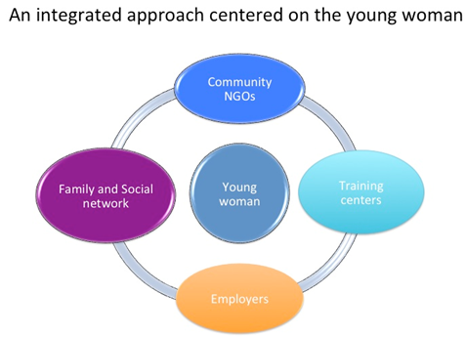
[3] How to implement a soft skills program to enhance a technical skills program?
Design of project
Technical (hard) skills
+ Soft skills
+ On the job (internships)
Soft-skills Administration :
--In parallel to the technical training
- Intensity: once a week – on week-ends
--Duration: 90-120 minutes
--Teacher-Student ratio: 1 to 25

Slide 12
Teaching Soft-skills
In theory, teaching methods should be tailored to soft skills by moving away from teacher-centered methods towards student-centered methods that promote team spirit and creative thinking.
This is a complex and lengthy task and will require a change in teaching mentality and significant teacher training. (question of quality and standardization of training)
Notes:
- In the short term, some soft skills could be taught with traditional methods. Soft skills such as team spirit, analytical thinking and creativity
could – to a certain extent – be taught using traditional methods. Modules for teaching a subset of soft skills could therefore be developed and
adapted to the needs of each sector, since some soft skills requirements (such as creativity) change as much with the sector as do technical skill requirements. The teaching of soft skills remains an under-investigated field, however, in particular in low-income settings, so significant investments in piloting, monitoring and evaluating such interventions
should be made before envisaging large-scale expansions.
Methods used by some NGOs to impart soft skills could be further investigated and adopted. Through their focus on disadvantaged youth,
some Haitian NGOs have developed methods to impart soft skills.
These NGOs often benefit from the students residing in the given area (quartier), which means that their approach can be more holistic and go beyond classroom hours. Nevertheless, they remain a valuable source of expertise.

Slide 13
[4] Why we need to know more (and about what)?
With relevance established, the ‘how to’ agenda takes central stage:
‘Right’ Design
  crucial question: Which Skills?
‘Right’ Implementation
  key unknown: Which modality?
An agenda for the future: Piloting, Monitoring and Evaluating interventions before embarking in large scale expansions.
Importance of soft-skills in their own right established but also important in connection to the efficiency and cost-effectiveness of skills and jobs training.
Especially important to “level the playing field” in the case of vulnerable populations.

Slide 14

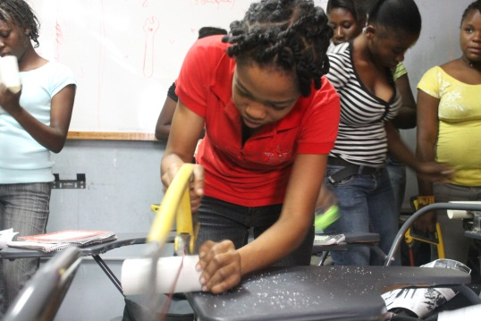
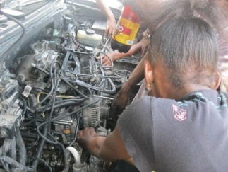
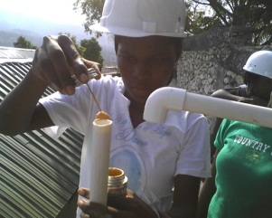
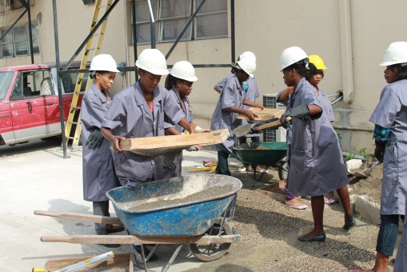
Thank you!

